Slide 1
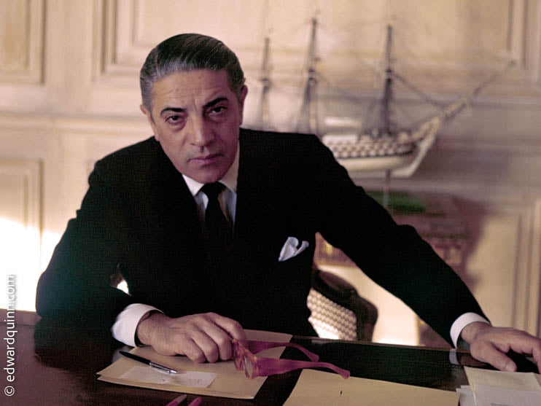
The beginning and the end of a Legend
Fragkiski-Ioanna Sofiou
Fn.7748
Vth year Medical Student
Gr.42
Supervisor: Dr. Vasilka Nikolova
Medical Humanities Sofia, 14 May 2022

Slide 2
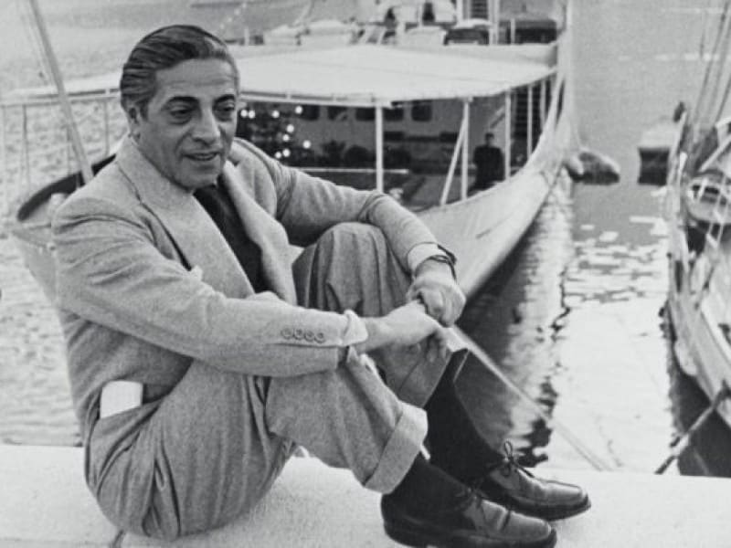
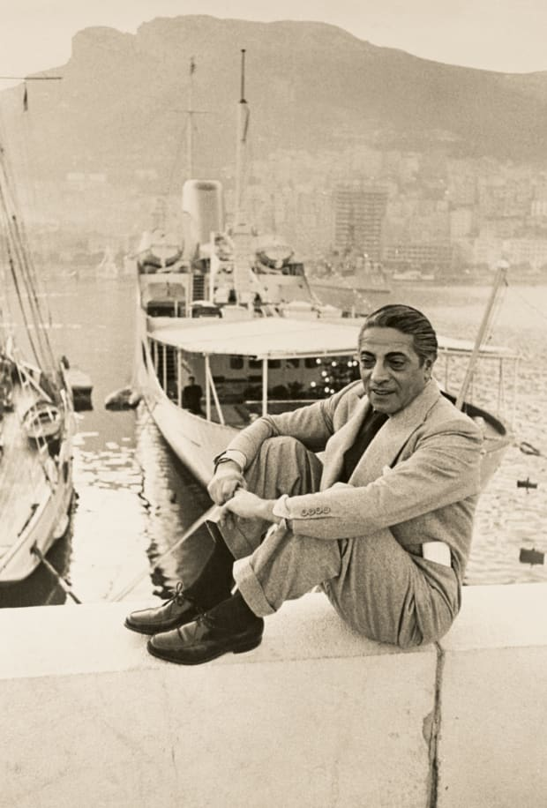
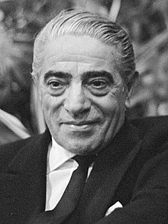
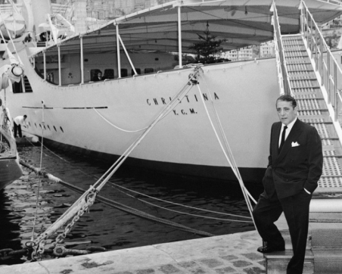
Aristotle Onassis (Aris or Aristos) 1906-1975

Slide 3
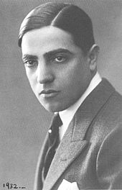
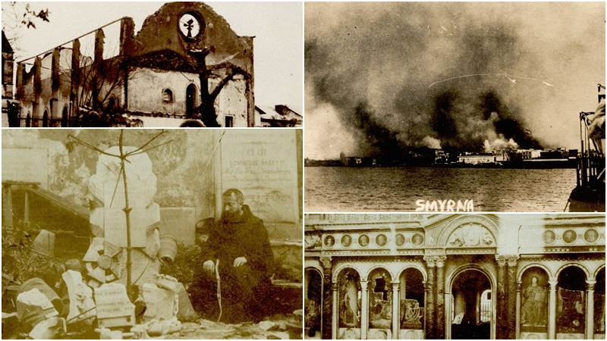
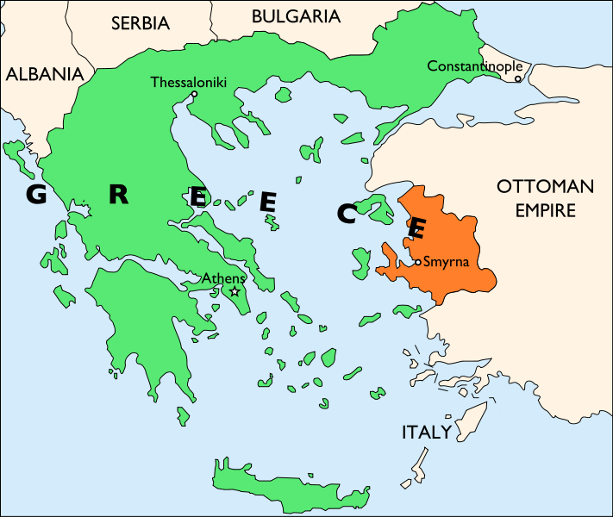
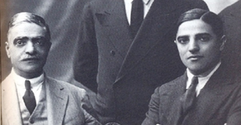
Early Life
Born in Smyrna in 20 January 1906 (2nd child of the family)
Mother (Penelope Dologlou) married at 17y.old and died at 33y. old
Father (Socrates Onassis) richest tobacconist in Smyrna
(remarried after 6 months from the death of his 1st wife – total 4 children)
1922-the catastrophe of Smyrna, his father got in prison and the tobacco firm was captured by Turks
At 16 y. old, arrived in Greece - returns to Istanbul
1923 travels to Argentina with 250 dollars
Worked in different domains
Create a new brand of cigarettes
At age of 25y. old, earn his first million

Slide 4
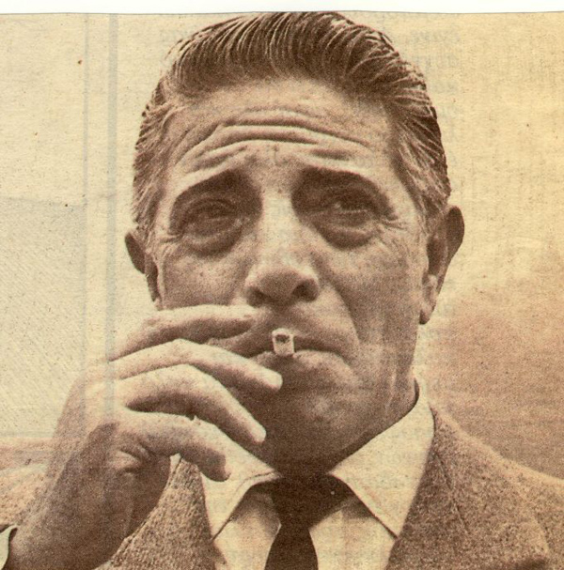
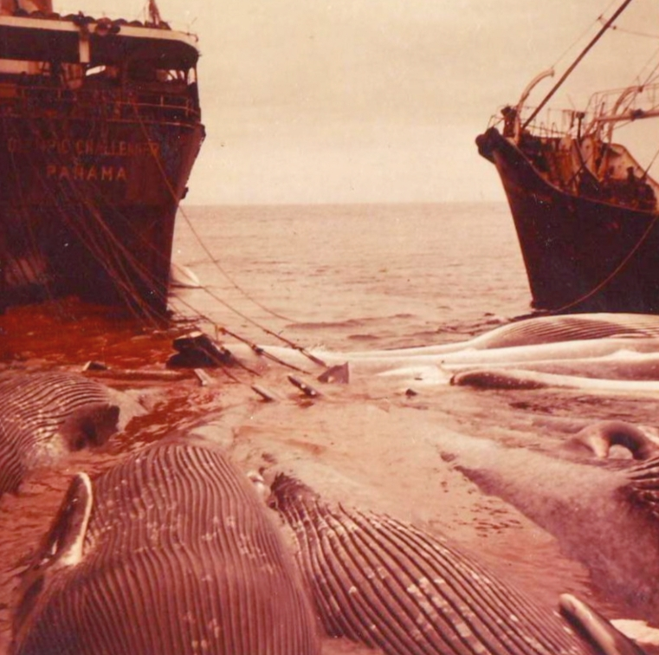
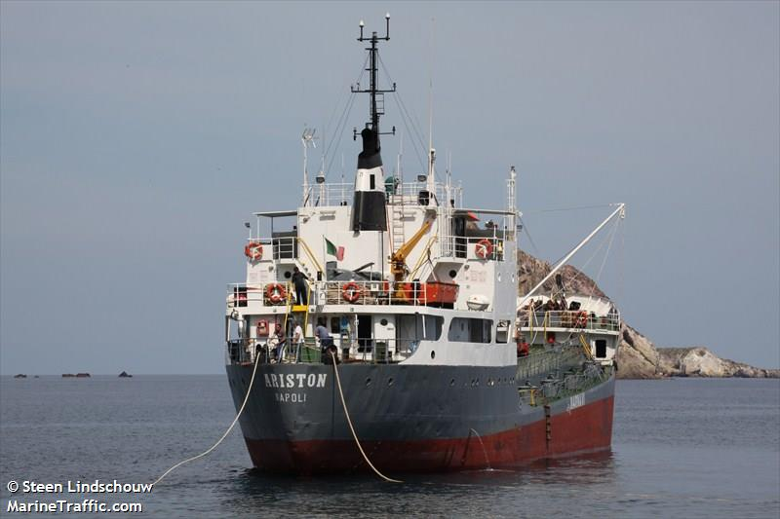
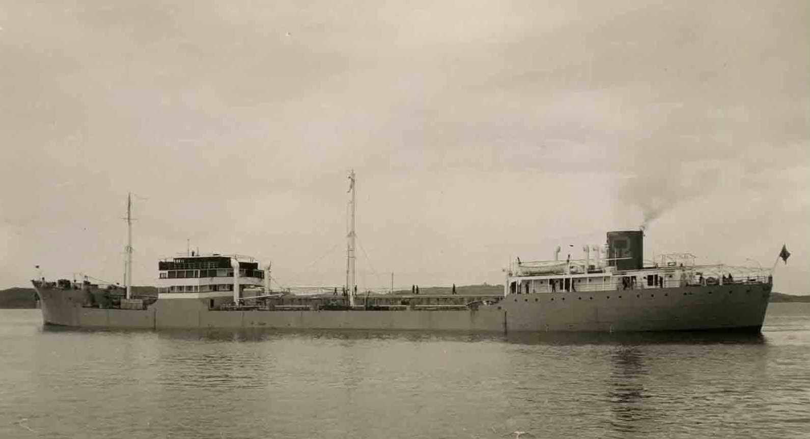
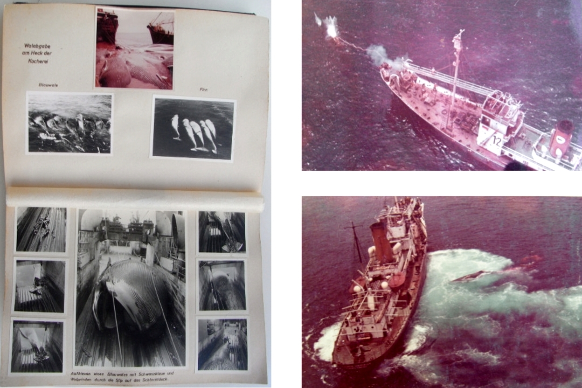
Infallible instinct
1931 – Deputy Consul of Greece in Buenos Aires
starts with shipping, realizing the opportunity of oil commerce and turning to tankers
1932 – bought from the Canadian Steamship Company six cargo remnants of the Great War
His first ships named after his parents
New opportunity- industrial revolution and role of whale’s oil
19 whale hunters- company in Panama -not entered into a contract for international whaling
1938 - first oil tanker built and 2 more added by II World War
after the war bought 23 Liberty ships from United States
First tanker (15.000 tons) –called «ΑΡΙΣΤΟΝ» by Götaverken, Sweden

Slide 5
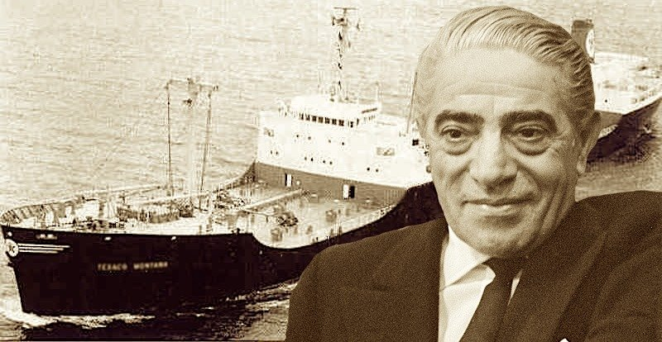
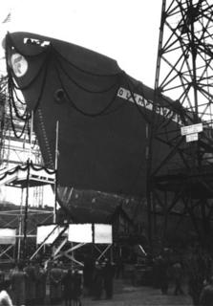
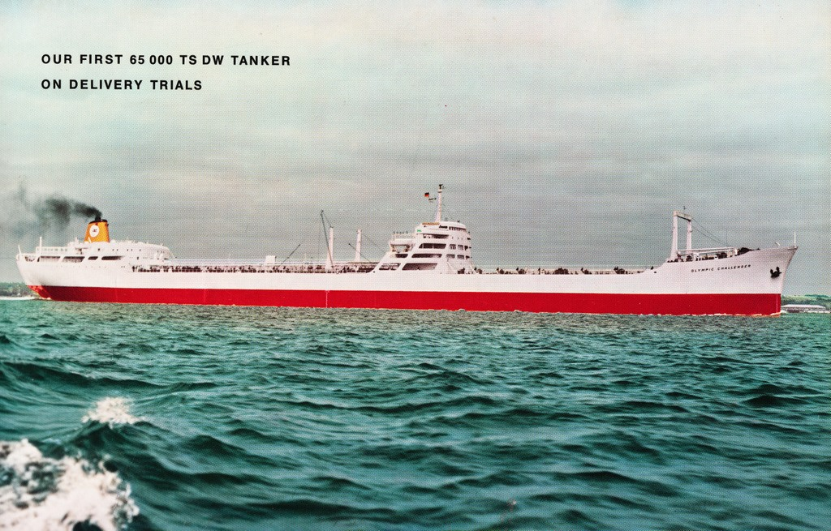
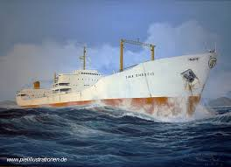
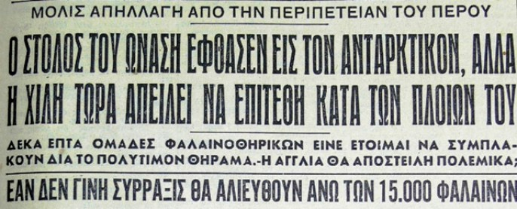
Professional Life
1952- established the Olympic Maritime
1953 - super tanker (46.000 tons) in Hamburg given the name “Athina-Tina” (his wife), also manages some theaters, casino of Monte Carlo
1954 – agreement with Saudi Arabia, the major newspaper of London named him “The leading figure in world shipping for 20th century” – Whale hunters fleet bombing from Peru
(he had 100% insurance)
1953
“Olymbic Challenger”
65.000 tons
“Tina Onassis”
46.000 tons tanker

Slide 6
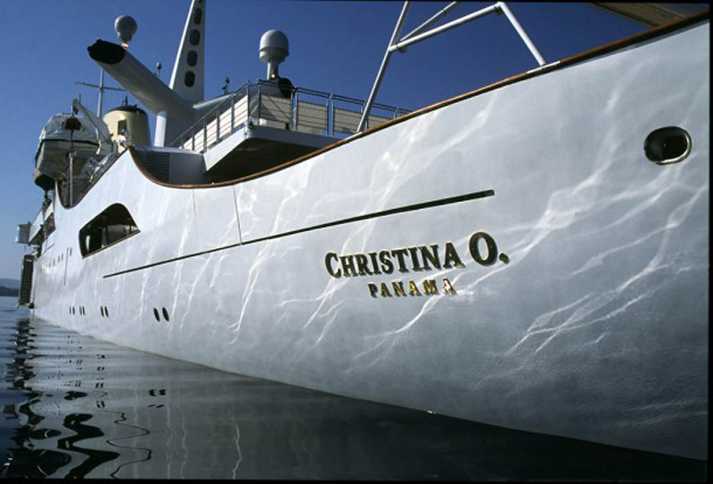
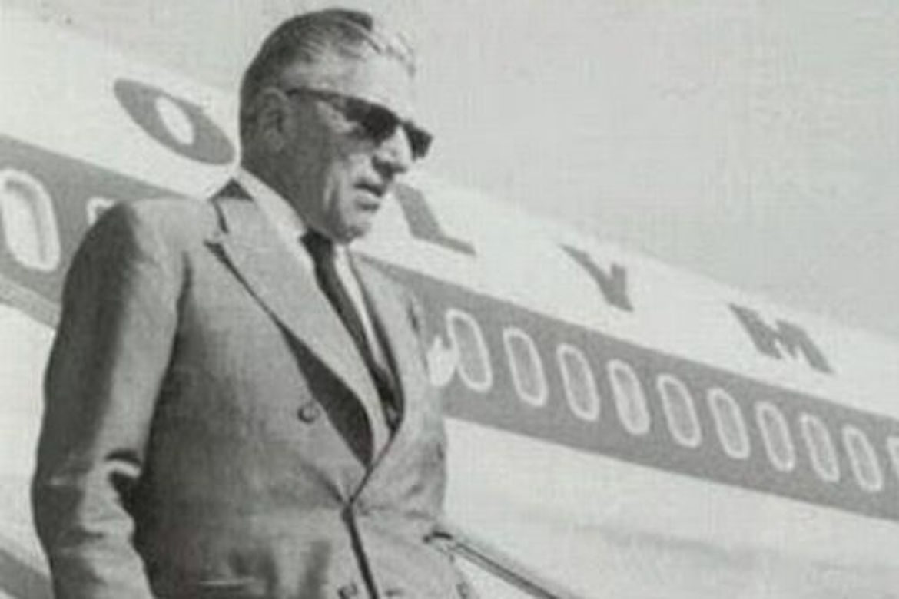
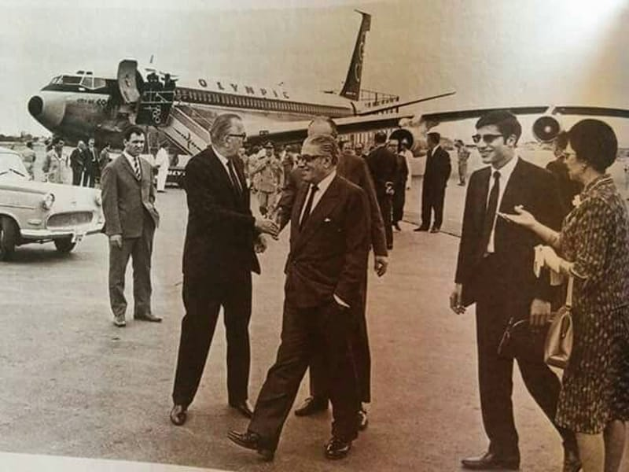
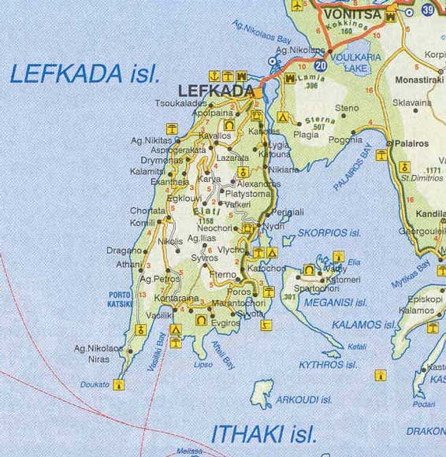
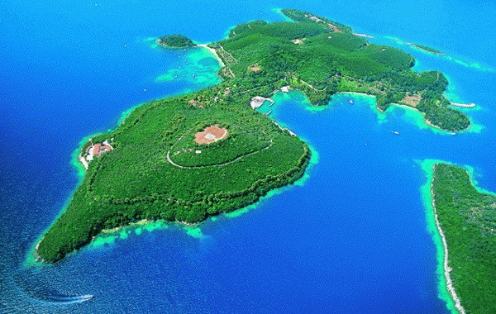
Other investments
1956 –buys from Greek the advance for Greek air travel- TAE and rename it Olympic Airways (keep it until his death end of 1974)
1963 – buys Scorpio (small island near Leukada) 3 mil. drachmas
1968 - Launch of Project Omega, a $400 million investment program
(oil refinery and aluminum smelter in Greece)

Slide 7
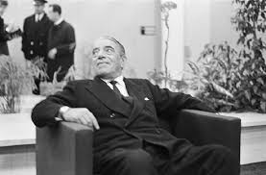
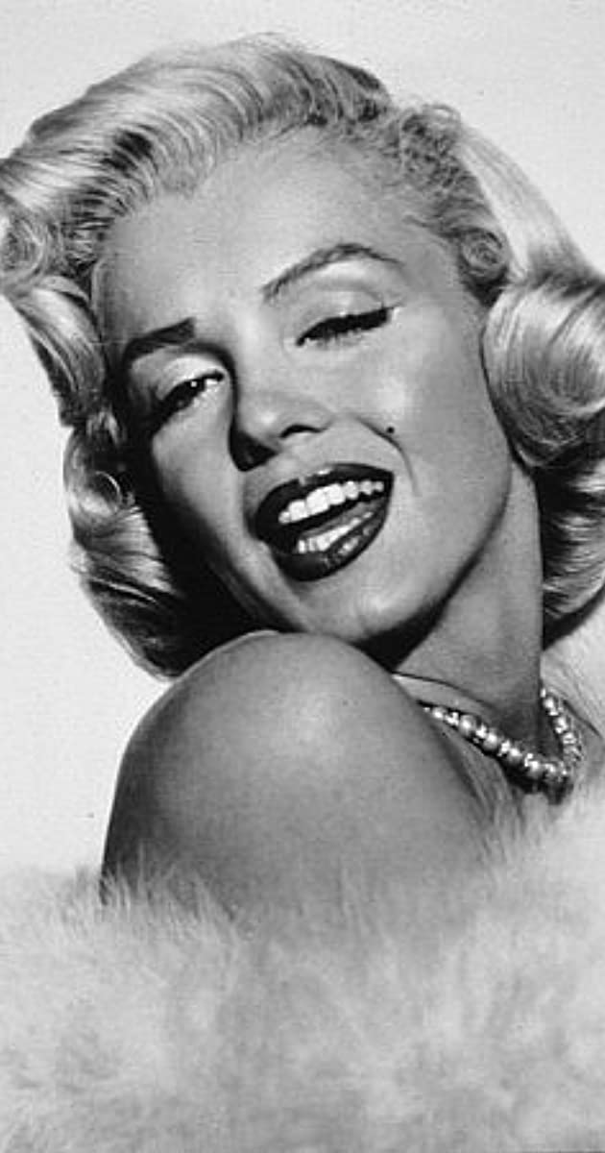
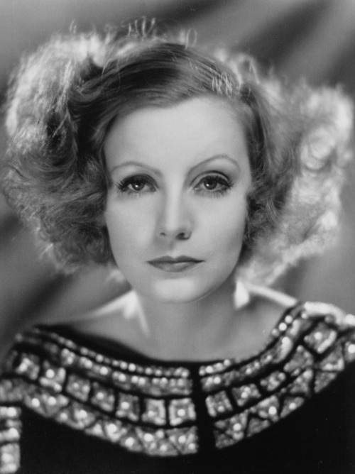
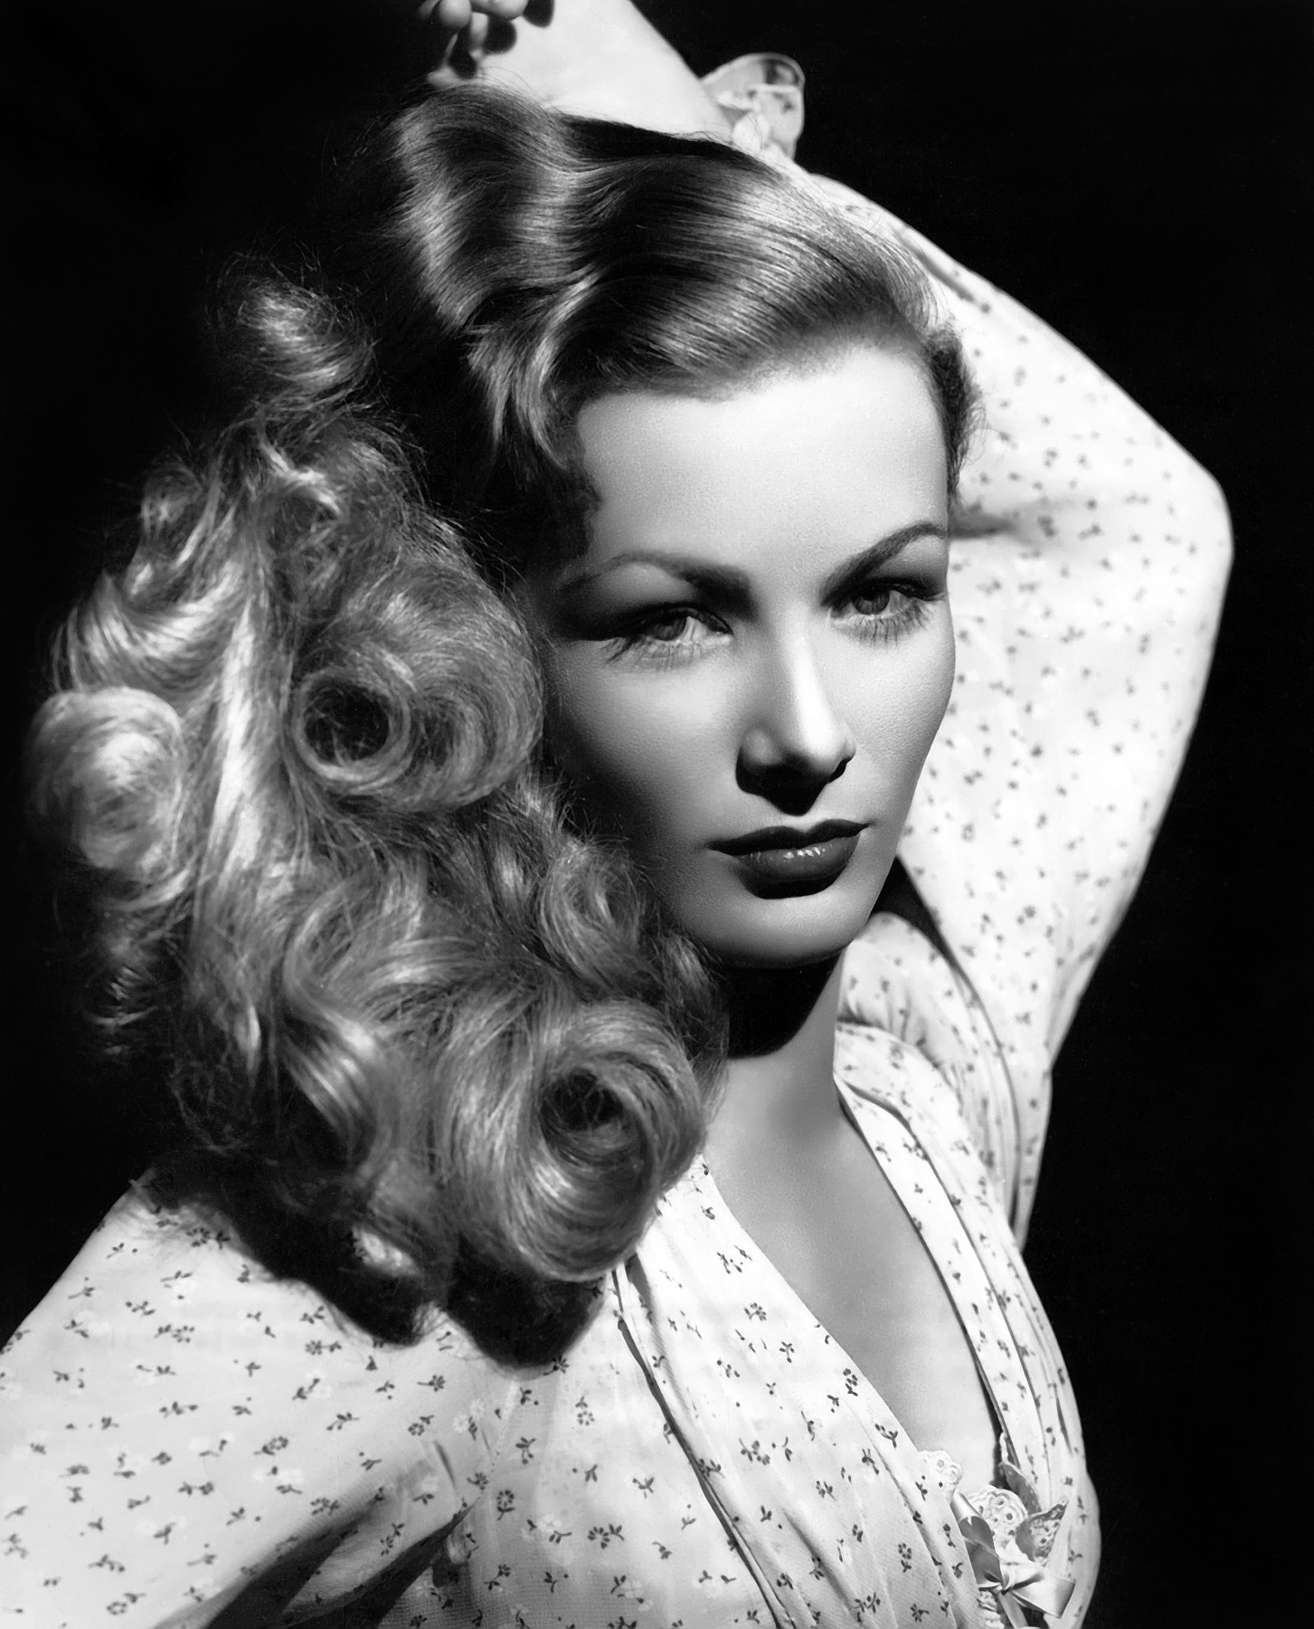
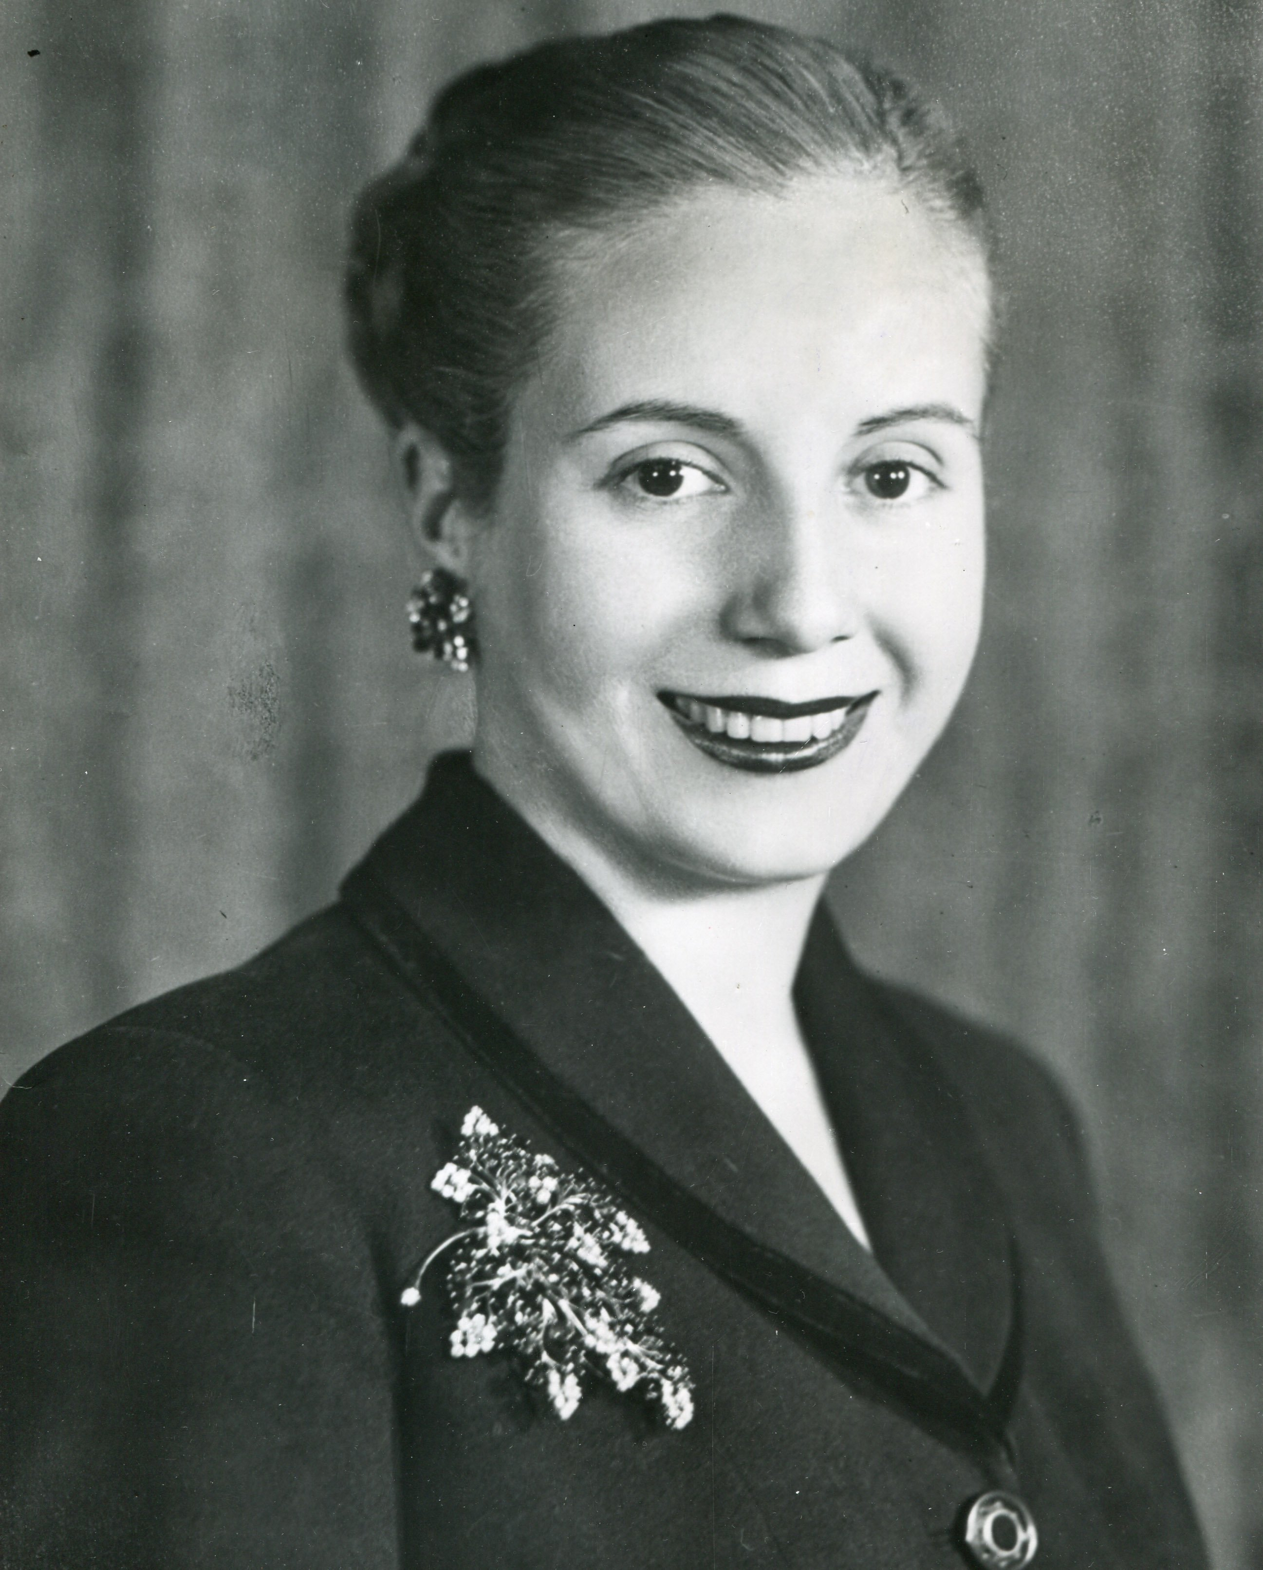
Personal Life
If women didn’t exist,
all the money in the world would have no meaning
In the beginning he was attracted from older women and
after he was dating only with famous women like Marilyn Monroe, Veronica Lake, Eva Perόn, and Greta Garbo

Slide 8
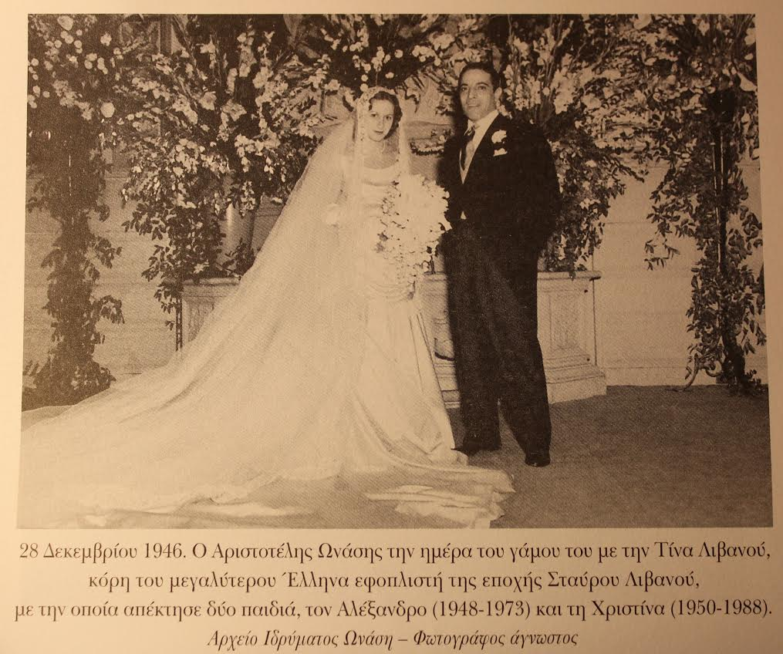
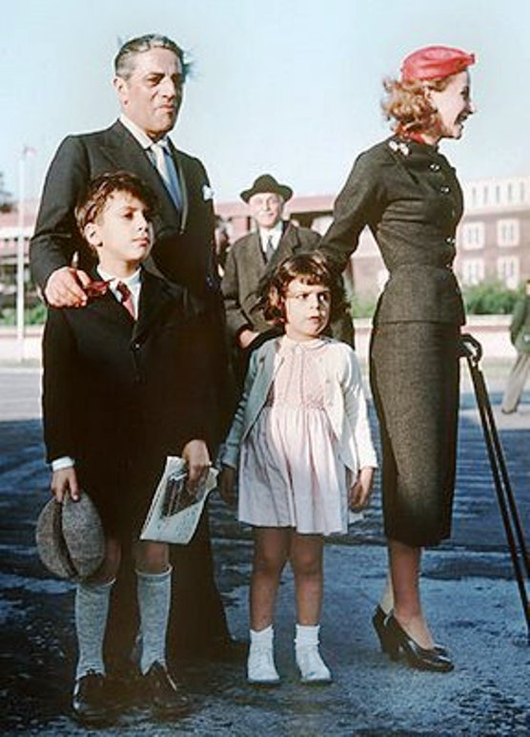
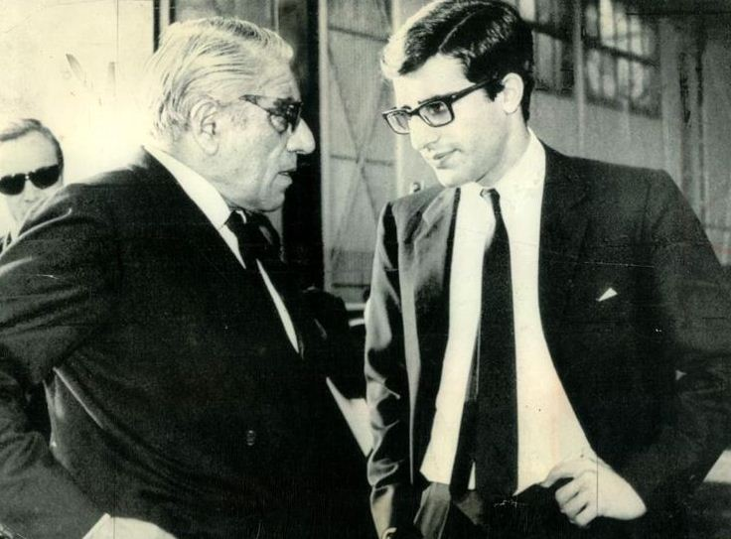
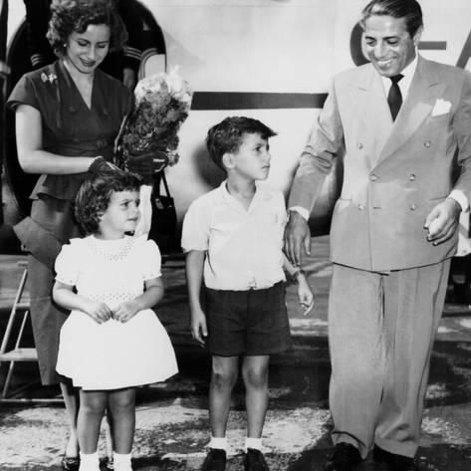
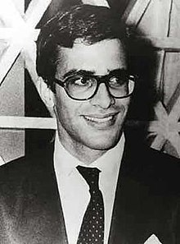
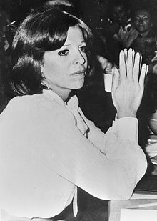
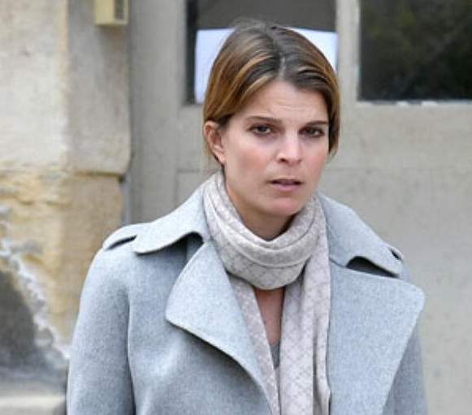
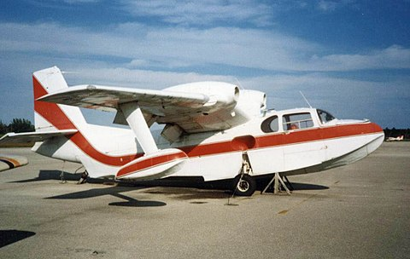
Onassis- Livanou (1946 –1960)
Athina (Tina) Onassi 16y. old - daughter of the biggest Greek ship-owner Stavros Livanos (meet in 1943), lived in Paris
2 children
Alexandros Onassis (1948– 1973 )
died at the age of 24y. old from a plane crash (Piaggio P.136L-2)
Christina Onassis (1950-1988) died at age of 37y. old, died from heart attack caused by pulmonary oedema
Athina Onassis (1985) – 37 y. old at the moment

Slide 9
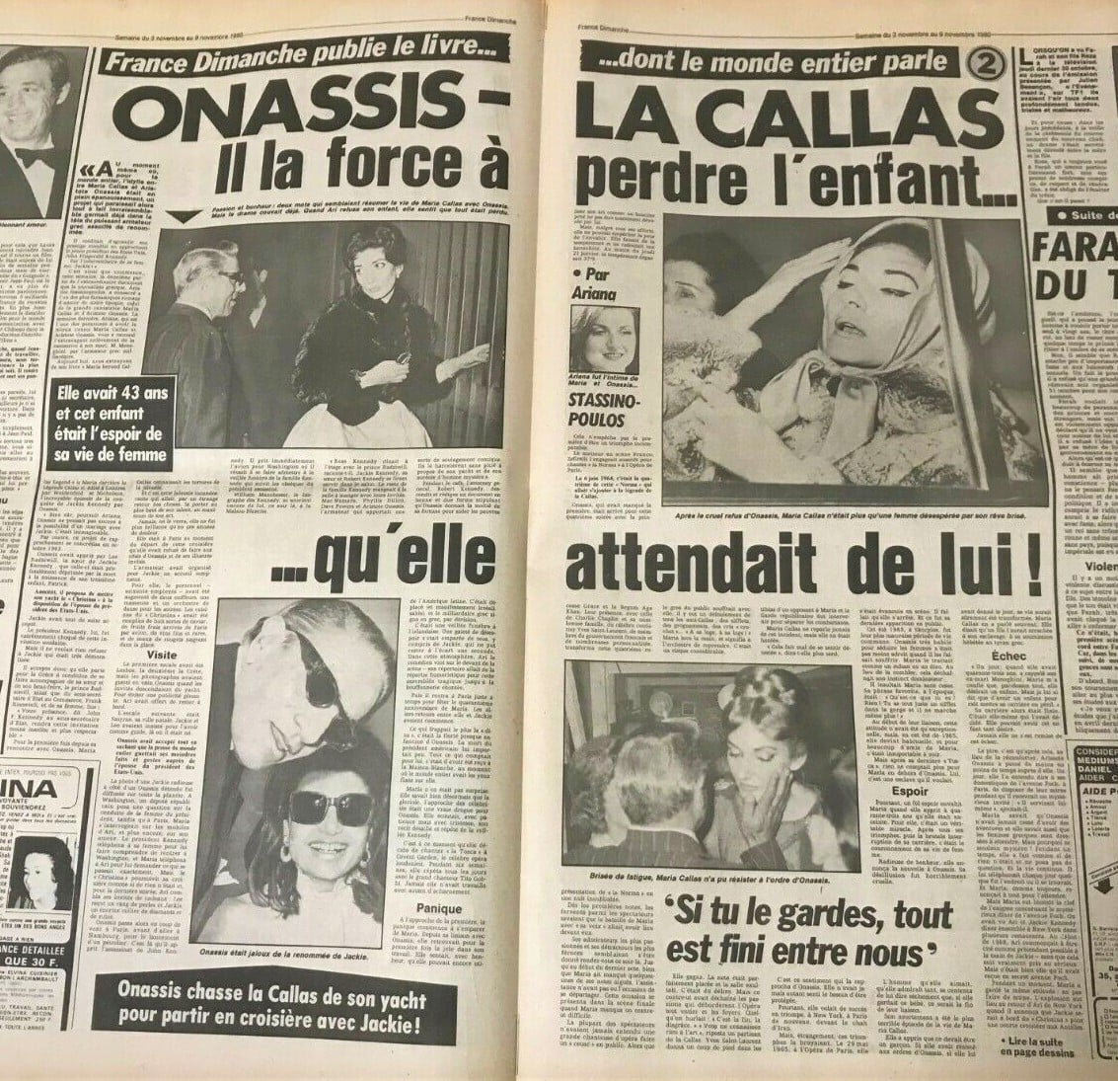
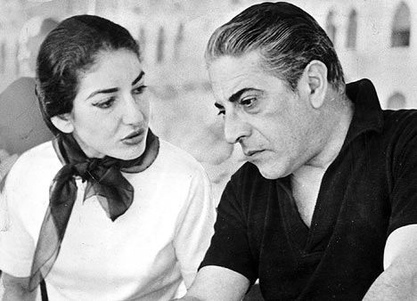
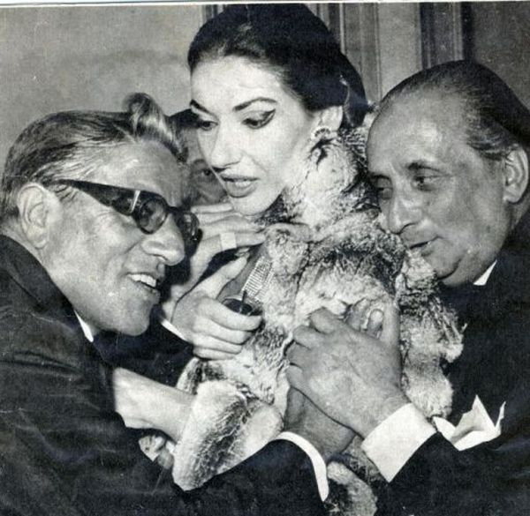
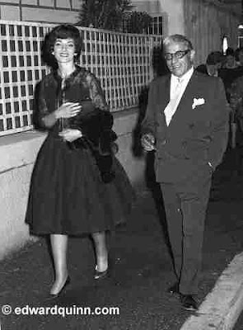
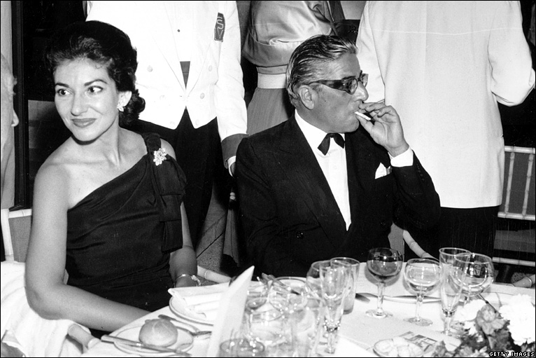
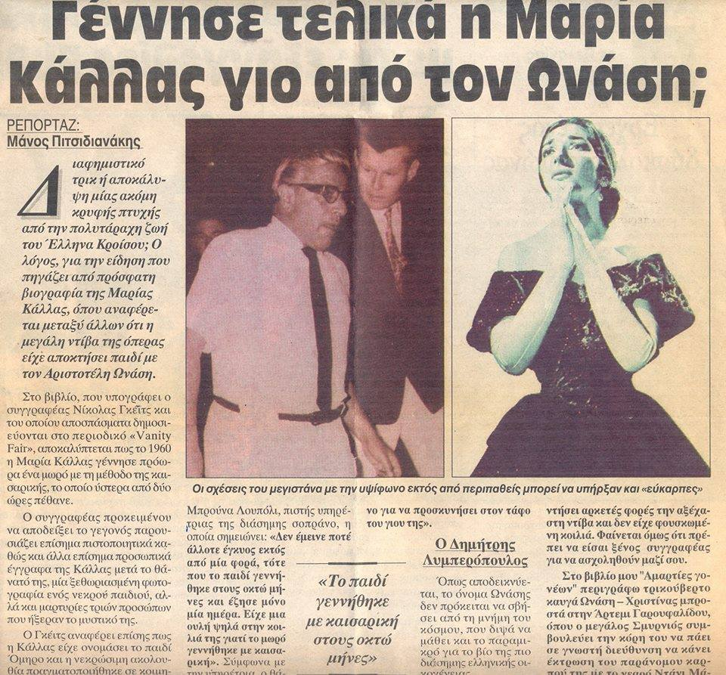
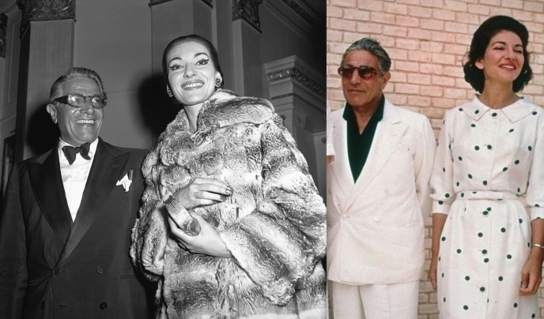
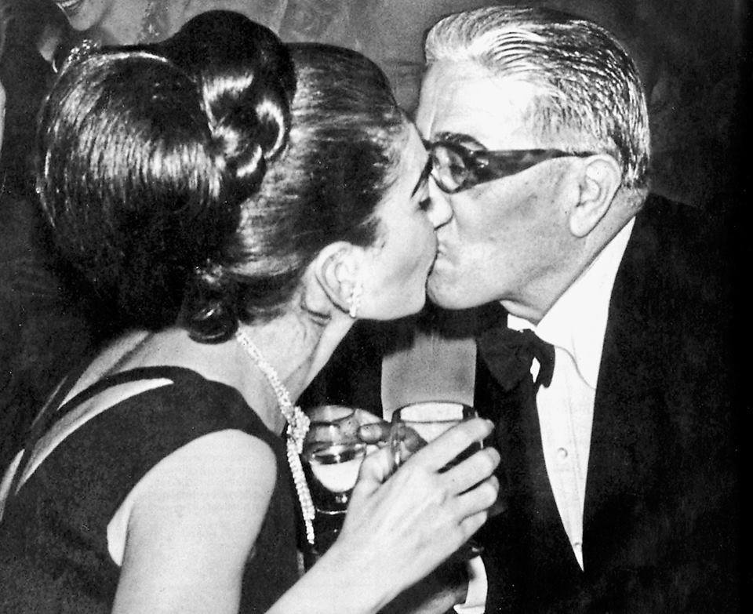
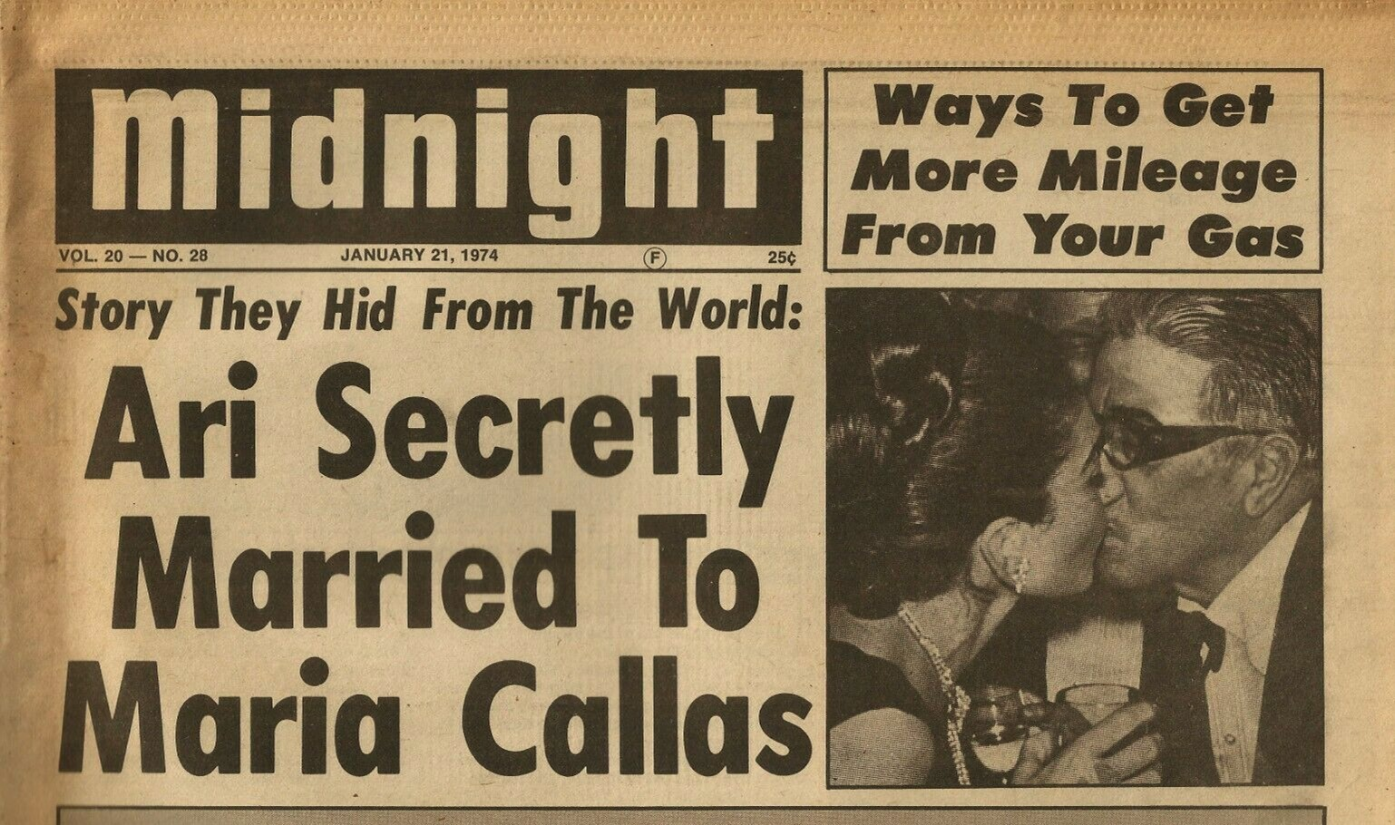
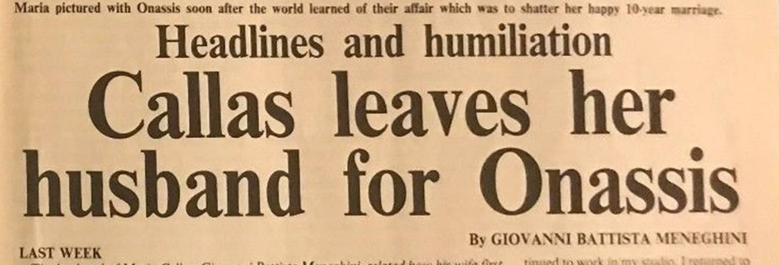
Onassis – Callas (1959-1968)
Meet the opera prima Dona (1957) in a party organized by Elsa Maxwell (American gossip columnist )
Both divorced: Onassis – Livanou and Callas- Meneghini
The relationship ends in 1968 for the new Onassis’ woman
Even after Onassis’ next relationship, Onassis visited Callas frequent in Paris
Its said that
Callas was the only true love in the Onassis’ life

Slide 10
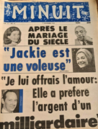
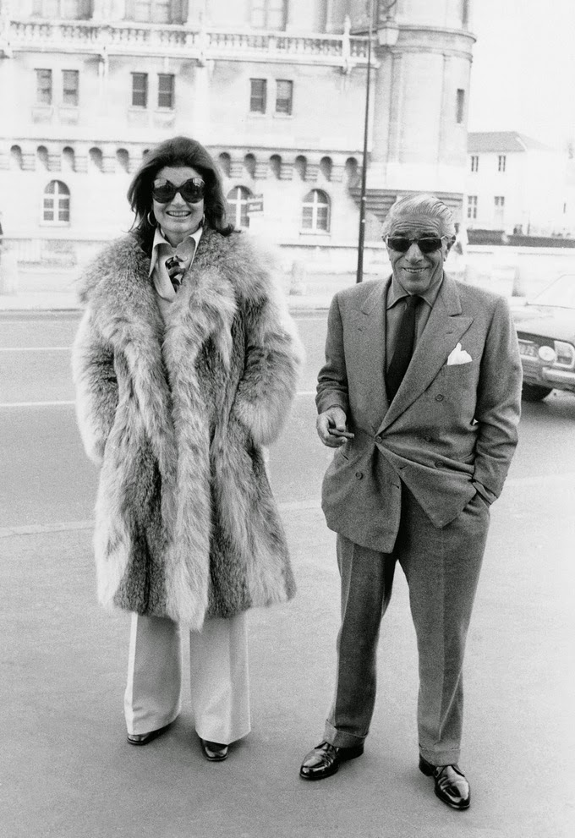
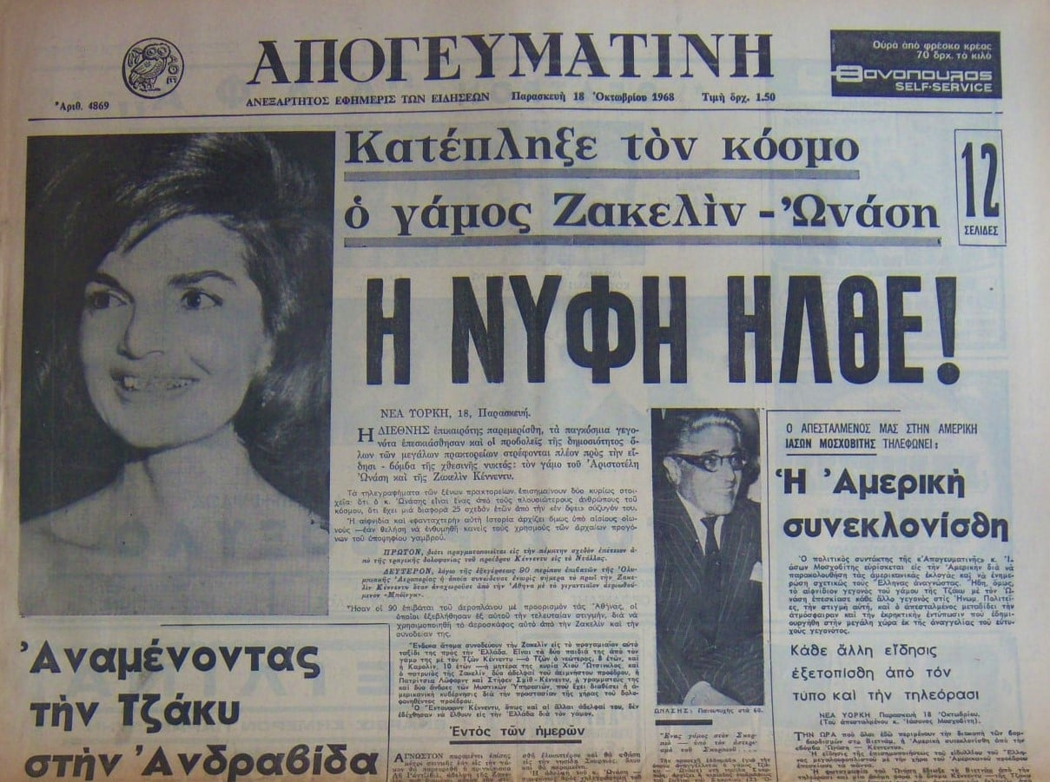
Onassis – Kennedy (1968 -1975)
Meet Jacqueline Lee Kennedy (Bouvier) in 1963, first lady of U.S. (1961-1963)
Married 20 Oct. 1968 in Scorpios’ island
(after the murder of her husband John Kennedy)
She had 4 children with Kennedy (2 of them died in infancy)
After his death she took 26 mil. dollars from Athina Onassis (Onassis granddaughter unique inheritor)

Slide 11
The decline
22 Jan. 1973 his son had an accident with the airplane and died due to brain injury, doctors remove the mechanical support
He believed that his son was murdered, and offered 1 mil. dollars in order to find evidences for sabotage
(valid and nowadays)
Dec. 1973 – fall of the world tanker market – lost 12.5 mil. dollars
15 Jan. 1975 - Olympic Airlines returns to Constantine Karamanlis

Slide 12
Health Problems
Depression
could not accept the death of his son, for 20 days was keeping the dead body of his son and spoke to him daily finally he didn’t attend the burial
Myasthenia Gravis
Chronic autoimmune, neuromuscular disease that lead to varying degrees of muscle weakness

Slide 13
Died - 15 March 1975
Suffer from Influenza (last 5 days)
Pneumonia - Respiratory Failure
complication of Myasthenia Gravis
69 y. old at the American Hospital of Paris
in Neuilly-sur-Seine, France
Buried next to the small church on Skorpios
(with his son and his sister Artemis)

Slide 14
1975- creation
Alexander Onassis Foundation
Half of Onassis estate was transferred after his death for the foundation incorporated in Vaduz, Liechtenstein: the Business Foundation, which acts as a holding company for the underlying business interests
Alexander S. Onassis Public Benefit Foundation which is the sole beneficiary of the Business Foundation, is based in Athens, Greece
Christina Onassis was the 1st the president of the foundation
Biggest in Europe
Create with $75 million Onassis Cardiac Surgery Center in Athens
Main priorities: Culture, education, the environment, health, and social achievement
Carrying out Aristotle Onassis’ original wishes, all the activities of the Foundation are exclusively related to Greece and Greek civilization

Slide 15
We must liberate ourselves from the
hope that the sea will calm down.
We must learn, sail even in strong winds.
Aristotelis Onassis

Slide 17
«Μηδένα προ του τέλους μακάριζε»
Solon
630-560 BC
Count no man happy until the end is known

Slide 18
References
"Onassis, Aristotle." Encyclopedia of World Biography, edited by Andrea Henderson, 2nd ed., vol. 24, Gale, 2005, pp. 286-288. Gale Virtual Reference Library.
Alexander Onassis Foundation , https://www.onassis.org/foundation/public-benefit-foundation
Aristotle Onasis, Facebook Page
Britanica, https://www.britannica.com/biography/Aristotle-Socrates-Onassis
Gnomicologikon, https://www.gnomikologikon.gr/authquotes.php?auth=195
Greek Aura, https://greekaura.wordpress.com/tag/marilyn-monroe/
Lefkada news, https://www.mylefkada.gr/lefkadas-secrets/onassis-photos-14133/
Meneghini, Giovanni Battista (1982). My Wife Maria Callas. New York: Farrar Straus Giroux. ISBN 978-0-374-21752-5.
Passty, Benjamin. "Onassis, Aristotle 1906–1975." History of World Trade Since 1450, edited by John J. McCusker, vol. 2, Macmillan Reference USA, 2006, p. 543. Gale Virtual Reference Library.
San simera, https://www.sansimera.gr/articles/838
Scott, Michael (1992). Maria Meneghini Callas. Boston: Northeastern University Press. ISBN 978-1-55553-146-1.
The Best Quotations, https://best-quotations.com/authquotes.php?auth=748
The New York Time, https://www.nytimes.com/1975/02/05/archives/onassis-is-ailing-with-two-diseases-specialist-on-way.html

Slide 19
Thank you
for your attention
“Navagio” beach in Zakynthos, Greece
Shipwreck of contraband “Panagiotis”, 1 Oct. 1980

